Slide 1
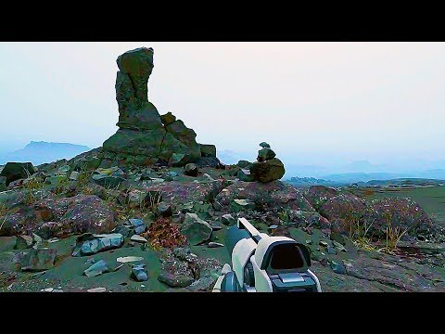

Slide 2
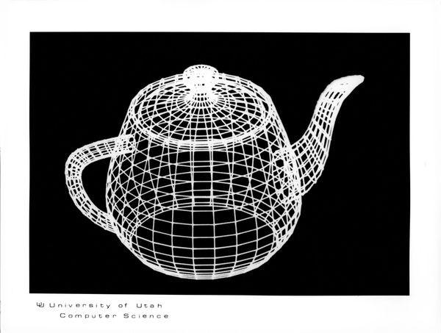
3D Graphics Workshop
Led by
Ethan Balcik
Image Source: https://www.computerhistory.org/revolution/computer-graphics-music-and-art/15/206
2/4/2021

Slide 3
Introduction to 3D Graphics:
The Mathematics and History of 3D Computer Graphics

Slide 4
A Brief History of Computer Graphics
1940s - 1970s
Late 1930s and early 1940s saw research into accurate lighting models
Meanwhile, in the 1950s, the first computer-aided design (CAD) systems were being researched at companies like Boeing, General Motors, and Bell Labs
In the 1960s, CAD and other computer graphics applications begin to take off within corporations and governmental sectors
In fact, William Fetter of Boeing coined the term computer graphics during this time
MIT’s Spacewar was the first arcade-style game, utilizing an analog CRT display
Undoubtedly influenced the development of arcade machines, which wouldn’t take off commercially for another 10-20 years later
Ivan Sutherland revolutionizes the field of computer graphics in the late 1960s, creating ten algorithms which solved many of the field’s fundamental problems
PONG is created by the soon-to-be founder of Atari games, Nolan Bushnell
The Utah Teapot is created in 1975 by Martin Newell of the University of Utah (pictured on the title slide)

Slide 5
A Brief History of Computer Graphics
1970s - 1990s (and onward)
Developments in abstracted & portable code took place in the mid 1970s
Late 1979, Jim Clark designs a “Geometry Engine”, which later evolves into his company Silicon Graphics
Advanced consumer computing technology utilizing computer graphics emerges in the early 1980s under brands like Microsoft and Apple
Introduction of the Graphical User Interface occurs during this time
Various films utilizing CGI (Computer Generated Imagery) are released throughout the 1980s
PIXAR was one company that emerged during this time, which most notably developed heavily sophisticated shader technology utilized in Toy Story
George Lucas’ Industrial Light & Magic furthered CGI to new highs in the 1990s
OpenGL introduced in 1992 by Silicon Graphics
1990s and onward saw the development & advancement of the GPU, and saw faster innovation in 3D graphics in gaming and multimedia than ever before

Slide 6
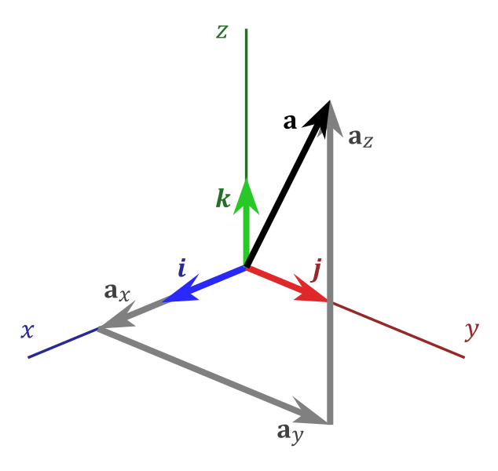
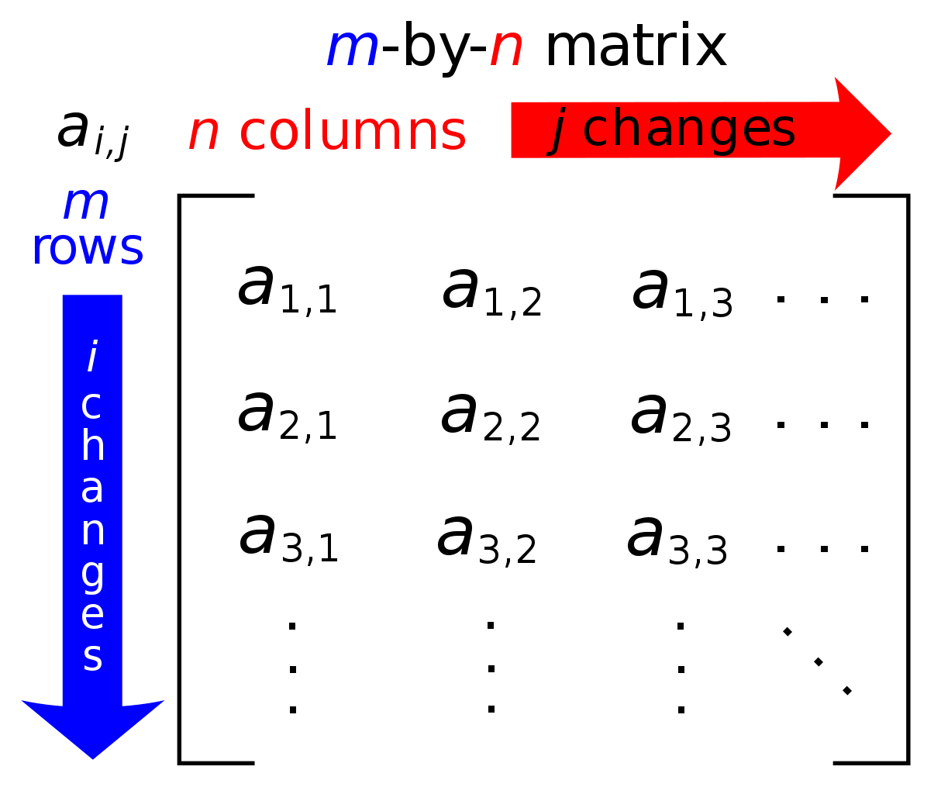
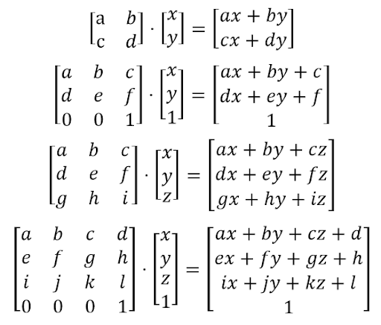
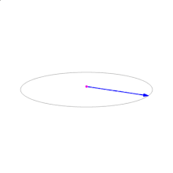
Mathematical Concepts for Computer Graphics
Vectors, Matrices, & a Basic Overview of Relevant Linear Algebraic Concepts
A vector is a list of n numbers specifying the coordinates of a point in an n-dimensional cartesian space
A matrix is a table of m-by-n numbers specifying a transformation of n-dimensional cartesian space
Scaling multiplying a vector by a single constant number, thereby scaling the magnitude of the vector by that constant
Vector addition is the act of adding one vector’s coordinates to those of another
Matrix-vector multiplication is an operation that applies a transformation defined by a matrix to a vector
Matrix multiplication the act of combining many transformations into one
Cross product in 3-dimensional space takes in two 3D vectors and returns a vector perpendicular to those passed in ( this is the right-hand-rule! :D )
And a TON more math if you really want to get into computer graphics!
Image Sources: http://www.c-jump.com/bcc/common/Talk3/Math/Matrices/W01_0050_matrix_by_vector_mult.htm, https://upload.wikimedia.org/wikipedia/commons/thumb/6/6e/Cross_product.gif/330px-Cross_product.gif, https://upload.wikimedia.org/wikipedia/commons/thumb/b/bb/Matrix.svg/371px-Matrix.svg.png, http://www.chrisevans3d.com/pub_blog/maya-python-vector-math-primer/

Slide 7
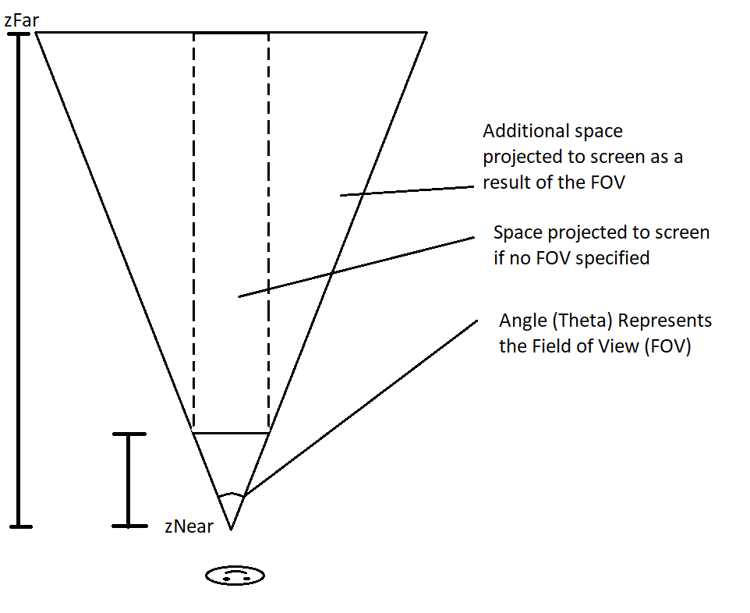
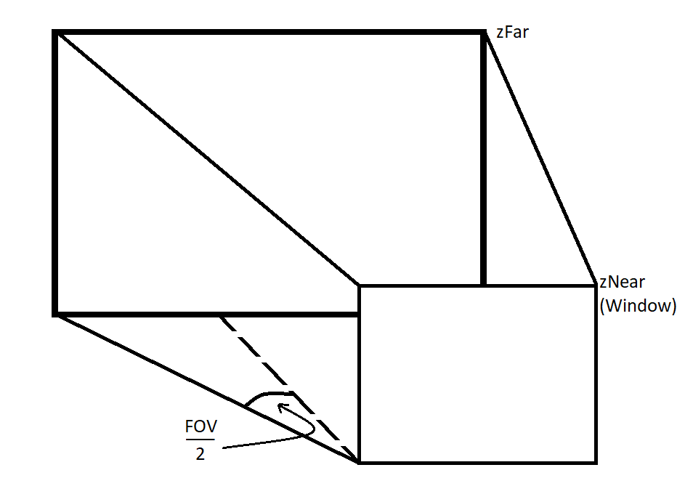
Mathematical Concepts for Computer Graphics
Projection to a Plane, or “Camera” (1 of 2)
Our window is our plane onto which we are projecting 3D objects
We do so using a couple of important numbers
Aspect ratio = window height / window width, normalizes our window coords
Field of view, an angle measurement of our peripheral limits
Depth between viewer and window
Maximum depth of the space, measured relative to the viewer
Notes:
Near boundary is our screen
Everything beyond that is the 3D space being projected onto the screen
zNear stays fixed because it would be hard to track in reality, and if it didn’t stay fixed, we would only see limited parts of the space, and we want to avoid this
Fix zNear in diagram
Define window in math & in software

Slide 8
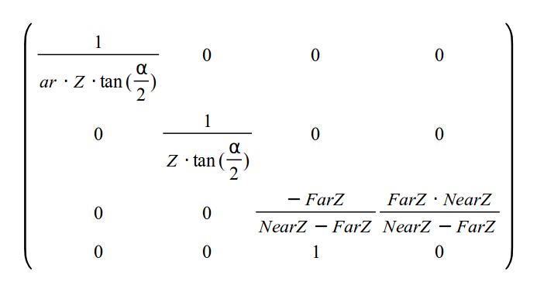
Mathematical Concepts for Computer Graphics
Projection to a Plane, or “Camera” (2 of 2)
The perspective projection matrix is derived using the numbers described previously, and each element adds its own set of desired properties
Element [0, 0] - Aspect ratio normalizes coordinates for the window, while the tangent expression results in the property of “zooming in” and “zooming out” as the field of view increases and decreases
Element [1, 1] - Same thing, except only concerned with the zooming property mentioned above
Elements [2, 2], [2, 3] - Normalize the z-coordinate
But wait, why is it 4D if we are operating in 3D?
3D vectors append an additional z-value, making it a 4D vector for the purpose of taking the z coordinate and using it to relate the x and y coordinates inversely to its depth
Further = less motion on screen, closer = more
Element [3, 2] stores the z value in camera space
Image Source: http://ogldev.atspace.org/www/tutorial12/12_11.png
Notes:
Only multiplies to the x for half the math in a given scene (2:1 or 16:9) - you scale x with respect to y
x and y are normalized between 0 and 1 & inversely related with z
z is also normalized between -1 and 1 with -1 being the zNear and 1 being the zFar
w is the z value in camera space and is used to inversely relate x and y with their depths

Slide 9
Mathematical Concepts for Computer Graphics
Rotation and Translation of the “Camera” (1 of 2)
We can imagine the viewer (or “Camera”) as positioned in a larger space
The camera itself is defined by 3 vectors
Position vector
Up vector (Assume this is, by default, [0, 1, 0])
Forward vector (Assume this is, by default, [0, 0, 1])
Rotating the camera up and down involves transforming the up vector’s y and z coordinates by trigonometric functions
Rotating the camera left and right involves transforming the forward vector’s x and z coordinates by trigonometric functions, and transforming its y coordinate by the up vector’s z coordinate transformation
The two must remain perpendicular (you’ll see why next slide)
Notes:
Can represent all upright projections with only 2 vectors
Up vector adds a degree of freedom which allows to view any image at any angle (although we limit rotation in our example project)

Slide 10
Mathematical Concepts for Computer Graphics
Rotation and Translation of the “Camera” (2 of 2)
We can imagine the viewer (or “Camera”) as positioned in a larger space
The camera itself is defined by 3 vectors
Position vector
Up vector (Assume this is, by default, [0, 1, 0])
Forward vector (Assume this is, by default, [0, 0, 1])
Moving the camera forward and backward involve simply adding a scaled forward vector to the position vector
Moving the camera left and right involves taking the cross product of the up and forward vector to receive a third vector which is perpendicular to both, and then adding this scaled vector to the position vector

Slide 11
OpenGL, and Other 3D Graphics Libraries:
Various Open Source & Industry Standard 3D Computer Graphics Libraries

Slide 12
The Khronos Group
OpenGL, WebGL, OpenGL ES, Vulkan
OpenGL is an open source, cross-platform graphics API
Developed by Silicon Graphics, inc., and has since been managed and expanded by the Khronos Group
Its applications include
Computer-Aided Design (CAD)
Virtual Reality & Flight Simulation
Scientific Visualization
Video Games
OpenGL ES is a well-defined subset of OpenGL desktop intended for use in low-power, embedded systems
WebGL is a cross-platform, royalty free web standard able to be recognized by OpenGL ES
WebGL brings plugin-free 3D to the web, implemented right in the browser
Vulkan is a next-generation, low-level graphics API, designed for more balanced CPU-GPU usage -- used by Steam for compatibility mode (still in prototype)

Slide 13
Other Graphics Libraries
Commercial & Internal Graphics Libraries
Microsoft DirectX - Direct3D
The ‘X’ in DirectX was used as the basis of the name “Xbox”
RenderMan Interface Specification (RISpec)
Developed by Pixar Animation Studios for rendering photorealistic 3D scenes
RenderWare
Developed before/during the emergence of GPUs
Once used for games able to be run on consoles including
GameCube
Wii
Xbox & Xbox 360
PlayStation 2 & PlayStation 3

Slide 14
OpenGL 3D Graphics Concepts
OpenGL Objects, Data Types, and Other Concepts (1 of 2)
A vertex is a 3D vector, or a list of 3 points specifying coordinates in space
A vertex array object (VAO) is a list of vertices, specifying the primitives of a “mesh”
Primitives in OpenGL include triangles, triangle strips, triangle fans, quads, quad strips, and polygons. In this workshop, we focus only on triangles.
A vertex buffer object (VBO) stores a VAO, but as unformatted memory allocated by the GPU
Double Buffering is the act of drawing to one buffer, while displaying another
Think of a buffer as a frame -- at any given time, there is one frame being drawn to, and one being displayed
When using double buffering, each time step the frames are switched.
A mesh is a common way to refer to a set of primitives conceptually

Slide 15
OpenGL 3D Graphics Concepts
OpenGL Objects, Data Types, and Other Concepts (2 of 2)
A shader is a program that takes in vertex data, draws it to the screen, and colors it on the screen
In OpenGL, shaders are written in GLSL, a C-like OpenGL language
A Vertex Shader actually does the job of projection (and other transformations in space) of vertices
A Geometry Shader takes simple primitives and transforms them as it sees fit
A Fragment Shader adds color and shading to “fragments”, or assembled primitives using vertex data

Slide 16
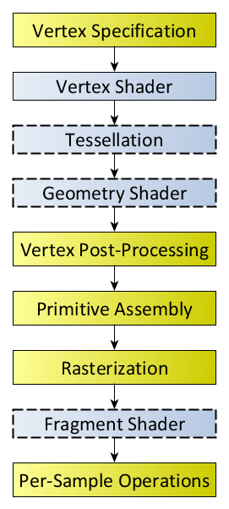
OpenGL 3D Graphics Concepts
The OpenGL Graphics Pipeline
VAOs/VBOs created by the programmer specify the vertices of a “Mesh”
Each vertex is processed by a Vertex Shader, also written by the programmer
Vertices are subject to optional tessellation and geometry shading
Vertex Post-Processing, Primitive Assembly, and Rasterization handled automatically by OpenGL
Rasterized Primitives are sent to the Fragment Shader for shading
At this stage, the fragment shader adds color to each of the fragments passed in
Further operations handled automatically by OpenGL

Slide 17
3D Graphics Programming in OpenGL:
An Object-Oriented Approach to 3D Computer Graphics Engine Programming

Slide 18
Object Oriented Programming Refresher
Simple Refresher on Object Oriented Programming Concepts (1 of 2)
A class is essentially a template for how data is formatted, similar to a struct in C, but more powerful and robust
A class can have variables (AKA, fields, properties, members), and functions (AKA, methods)
An object is an “instance” of a class
A class is used as a blueprint for the allocation of actual specified data
A constructor is a method defined in a class that creates the object & may initialize some of its properties
A destructor is a method defined in a class that destroys the object
A getter is a public method defined in a class that allows the programmer to access an object’s private properties when actually working with it
A setter is a public method defined in a class that allows the programmer to change an object’s private properties when actually working with it

Slide 19
Object Oriented Programming Refresher
Simple Refresher on Object Oriented Programming Concepts (2 of 2)
A public variable/method of an object can be accessed freely throughout the application whenever that object is in scope
A private variable/method of an object can only be accessed within its class
Part of the Object Oriented Programming philosophy dictates that variables, for the most part, should be declared as private, and only accessed through an object’s “interface”, or its methods
A static variable/method is a variable or method in a class to which all instances of that class share a common reference
I like to think of static variables & methods as being stored in the class itself, rather than the instances of that class

Slide 20
Unified Modelling Language (UML)
The Industry Standard for Visualizing an Object-Oriented Program
UML is not a programming language, but it is a standard way to visualize complex object-oriented programs
It communicates how classes and objects interact at a higher level than is easily detectable when analyzing source code alone
In UML, classes & objects are represented as boxes, and relationships between classes are represented as arrows
We will analyze what an Object-Oriented approach to writing a graphics engine might look like using a UML diagram

Slide 21
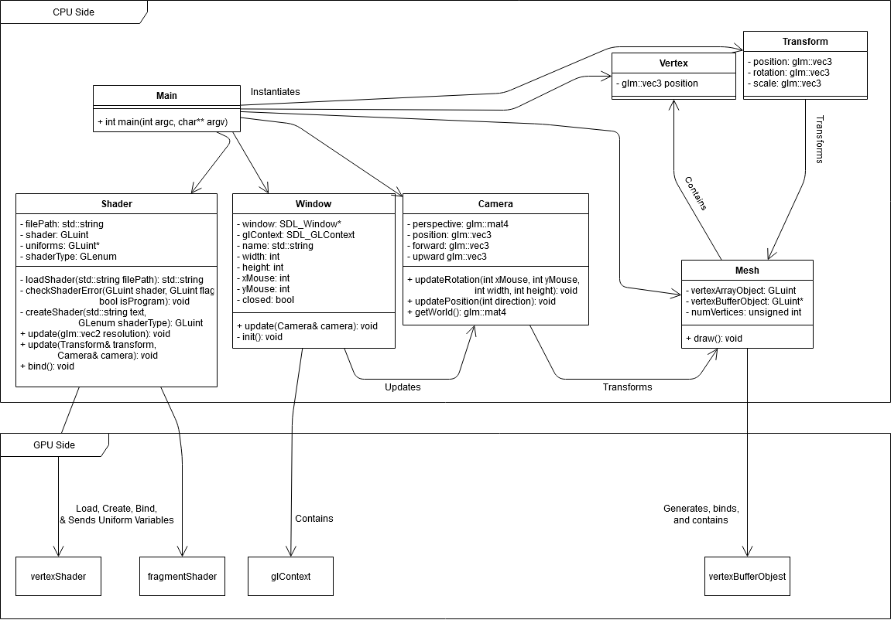
An Object-Oriented Graphics Engine
Example of an Object-Oriented Graphics Engine Visualized Using UML
‘-’ = private
‘+’ = public
Boxes with attributes = classes
Main technically isn’t a class, but it helps to visualize it as such
Boxes with no attributes = objects & other data
Arrows = relationships

Slide 22
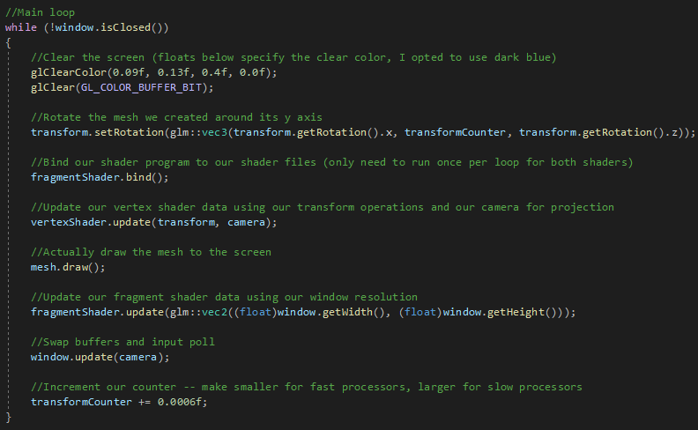
Analyzing the Source Code
The Main Loop
Notes:
Change comment

Slide 23
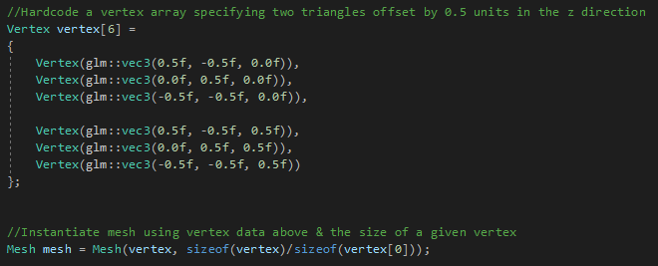
Analyzing the Source Code
What Does Our Mesh Look Like?
Ideally, meshes should be read in from files, not hardcoded

Slide 24
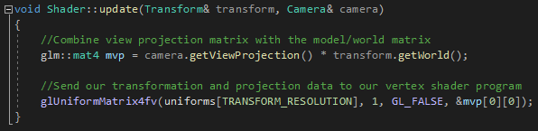
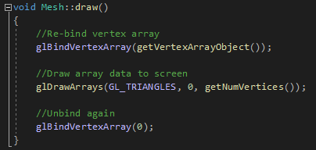
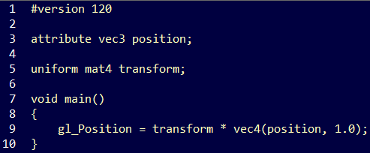
Analyzing the Source Code
How Does Our Mesh Get Drawn to the Screen?
{
Transform & Projection Matrix Uniform Variable
Shader.cpp
Happen Sequentially in Main Loop
Calls
Mesh.cpp
VertexShader.vs

Slide 25
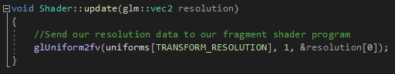
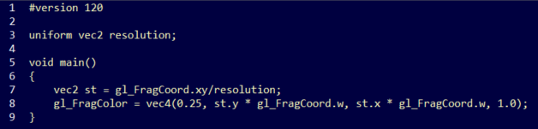
Analyzing the Source Code
How Does Our Mesh Get Colored?
{
Shader.cpp
VertexShader.vs
Vertex Stream
Resolution Uniform Variable
Happen Sequentially in OpenGL Pipeline
FragmentShader.fs

Slide 26
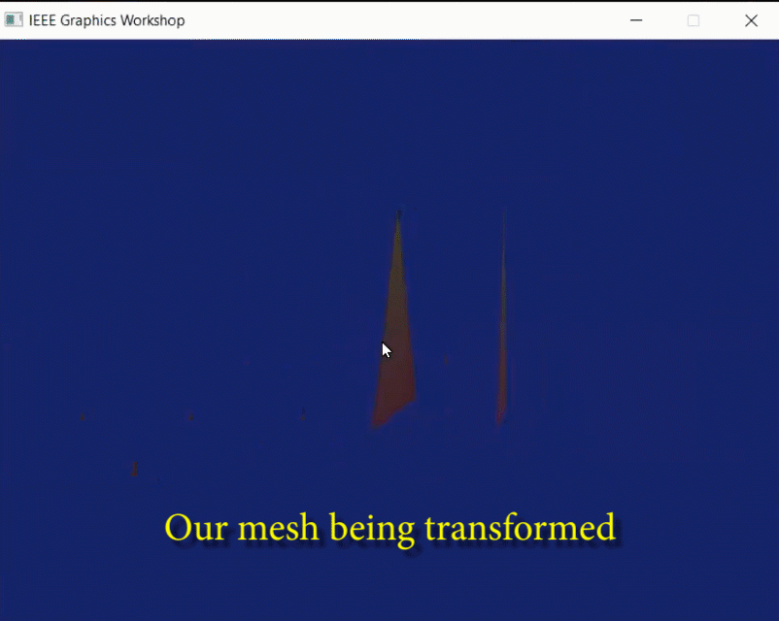
The Result
What Does It Look Like?

Slide 27
Writing Camera Transformation Functions
Writing a Camera Rotation Function (1 of 4)
Goal: Use mouse input to rotate the camera
Intuitively, this might be called “looking around”
Important collaborators in this process
Mouse x-coordinate, Mouse y-coordinate, Window aspect ratio, Camera up-vector, Camera forward-vector, Camera view projection
Any Ideas?

Slide 28
Writing Camera Transformation Functions
Writing a Camera Rotation Function (2 of 4)
Rotation left & right
Forward vector ([0, 0, 1] by default) x & z-coordinates “rotate” using trigonometric functions
Z-X plane where the z-axis is horizontal and the y-axis is vertical
Sine & Cosine imply some rotation
Sine returns the vertical coordinate, Cosine returns the horizontal coordinate
We will use the mouse’s normalized x-coordinate as input, multiplied by some radian angle
This isn’t necessarily the best design
It places a limit on how far upward and downward we can rotate
Better design would involve more persistence, and low-level control over our mouse

Slide 29
Writing Camera Transformation Functions
Writing a Camera Rotation Function (3 of 4)
Rotation up & down
Up vector ([0, 1, 0] by default) y & z-coordinates “rotate” using trigonometric functions
Y-Z plane where the y-axis is horizontal and the z-axis is vertical
Sine & Cosine imply circular rotation
Sine returns the vertical coordinate, Cosine returns the horizontal coordinate
We will use the mouse’s normalized y-coordinate as input, multiplied by some radian angle
This isn’t necessarily the best design
It places a limit on how far upward and downward we can rotate
Better design might involve more persistence, and low-level control over our mouse

Slide 30
Writing Camera Transformation Functions
Writing a Camera Rotation Function (4 of 4)
Rotation left & right (revisited)
Forward-vector & up vector MUST REMAIN PERPENDICULAR!
We need to update the forward-vector’s y-coordinate using the up-vector
If the up-vector’s y is 1 (as it is by default), then the forward-vector’s y should be 0 (also as it is by default)
So, we can’t use the up-vector’s y-coordinate for this (without some extra, unneeded work)
How about the up-vector’s z-coordinate?
The up-vector’s z-coordinate increases as its y-coordinate decreases, vice versa
By default, the up-vector’s z-coordinate is 0
Sounds pretty perfect to use to transform the forward vector
Forward vector’s y-coordinate = (default value - up-vector’s y-coordinate)

Slide 31
Writing Camera Transformation Functions
Writing a Camera Translation Function (1 of 3)
Goal: Use keyboard input to translate the camera
Intuitively, this might be called “moving around”
Important collaborators in this process
W-A-S-D Keys, Camera position vector, Camera up-vector, Camera forward-vector, Camera view projection
Any Ideas?

Slide 32
Writing Camera Transformation Functions
Writing a Camera Translation Function (2 of 3)
Motion forward & backward
Position vector ([0, 0, -3] by default)
Perhaps we could just add/subtract the forward vector onto/from the position vector on key input?
Addition = forward
Subtraction = backward
In order to reduce choppiness, we should locally scale down the forward vector before adding/subtracting it onto/from the position vector

Slide 33
Writing Camera Transformation Functions
Writing a Camera Translation Function (3 of 3)
Motion left & right
Position vector ([0, 0, -3] by default)
What is left & right relative to the camera?
Remember, we can rotate the camera around in space, and so left & right changes on this rotation
Well, left & right with regard to the direction that the camera is facing can be determined by taking the cross-product of the forward and up-vectors
This is why they need to stay perpendicular!
This returns a vector perpendicular to BOTH the forward & up-vectors
Under this context, it returns a “right-vector”
We can simply add a scaled “right-vector” to the camera’s position vector to move right
We can subtract a scaled “right-vector” from the camera’s position vector to move left

Slide 34
Works Cited
Thanks for stopping by!
AtSpace (n.d.), Tutorial 12 - Perspective Projection. AtSpace, Accessed 12 January 2021, http://ogldev.atspace.org/www/tutorial12/tutorial12.html
The Benny Box (9 January 2014), Intro to Modern OpenGL. YouTube, Accessed 2 January 2021, https://www.youtube.com/watch?v=ftiKrP3gW3k&list=PLEETnX-uPtBXT9T-hD0Bj31DSnwio-ywh
Carnegie Mellon (n.d.), History of Computer Graphics (CG). The Computer Graphics Book of Knowledge, Accessed 8 January 2021, https://www.cs.cmu.edu/~ph/nyit/masson/history.htm
De Vries, Joey (n.d.), Geometry Shader. learnopengl, Accessed 8 January 2021, https://learnopengl.com/Advanced-OpenGL/Geometry-Shader
Gonzalez Vivo, Patricio & Lowe, Jen (n.d.), The Book of Shaders. thebookofshaders, Accessed 8 January 2021 https://thebookofshaders.com/03/

